Slide 1
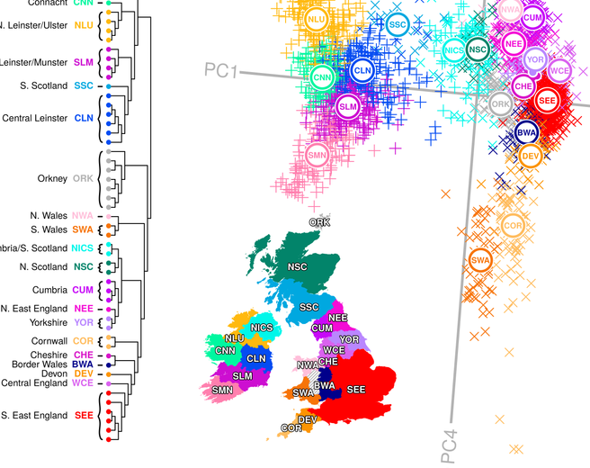
Cluster Analysis

Slide 2
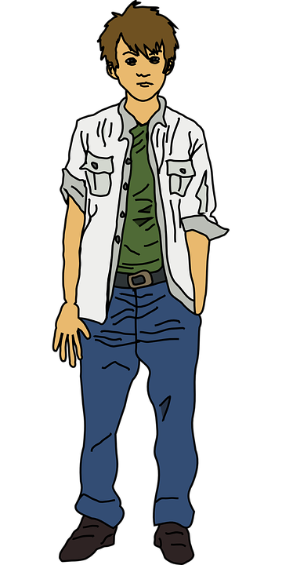
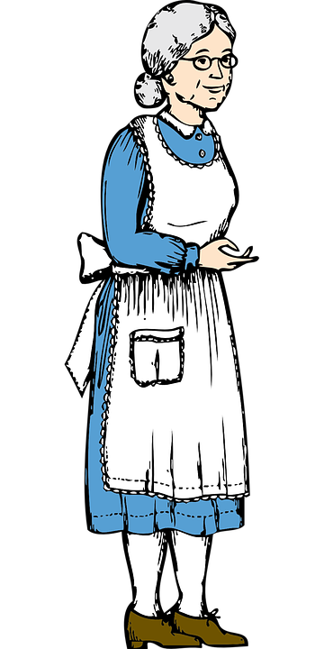
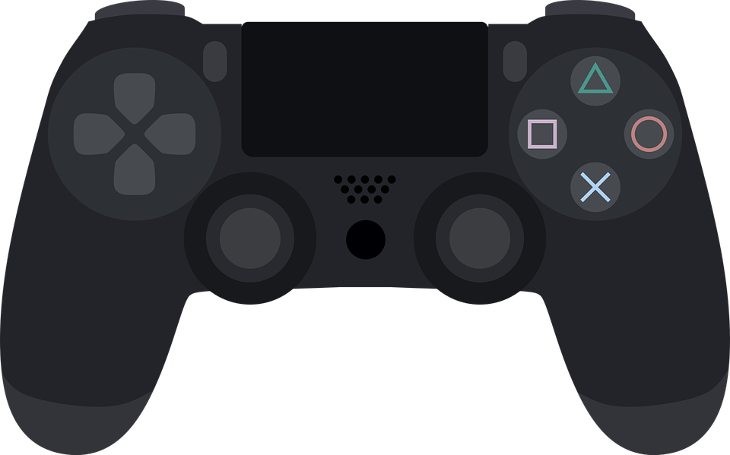
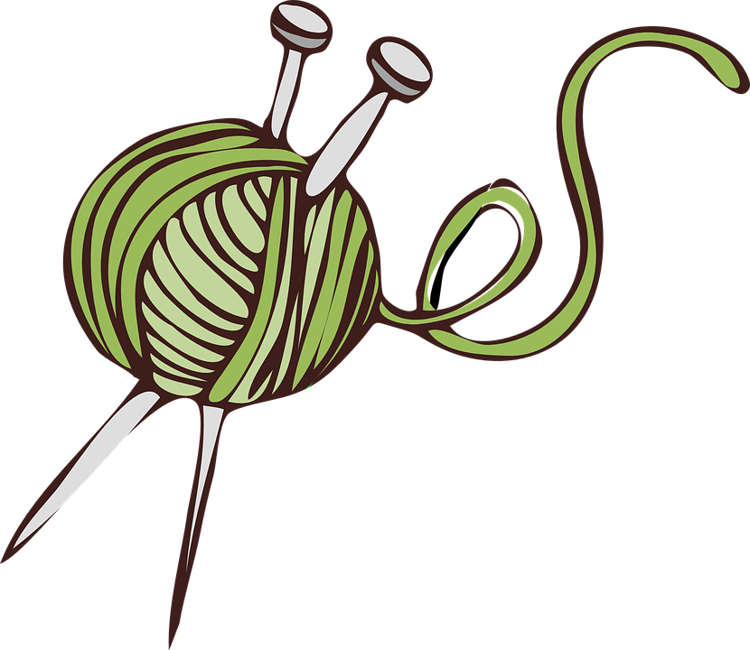
Check out this new video game !
Discounts on knitting needles !

Slide 3
Interest for knitting
Knitting teenagers
Knitting & elderly
Customer segmentation
Age
Gamers & teenagers
Gamers & elderly
Interest for gaming

Slide 4
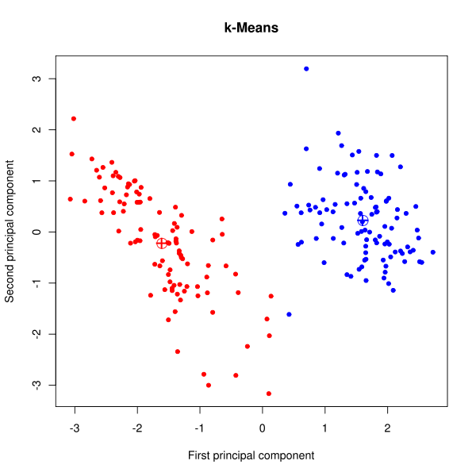

Slide 6
What k-means algorithm does for you

Slide 7
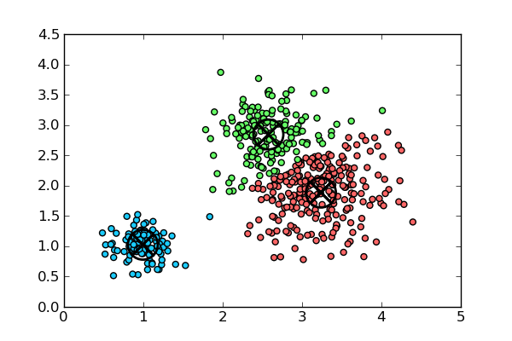
K (in k-means) is the number of clusters
The algorithm does not choose the number of clusters

Slide 8
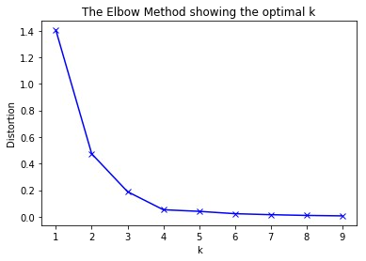
Elbow plots to chose the number of clusters
Look for the « break »

Slide 9
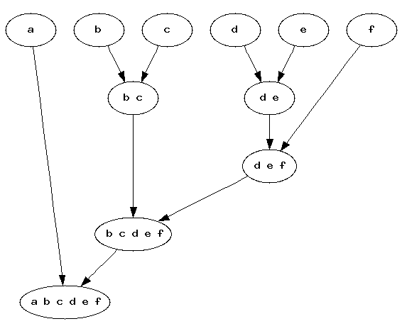
Hierarchical clustering works differently
Agglomerative clustering

Slide 10
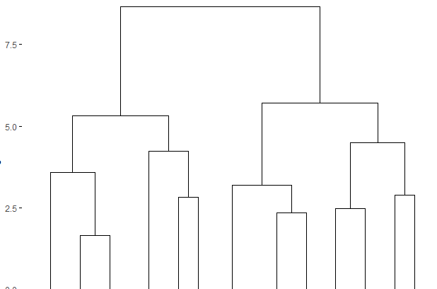

Slide 12
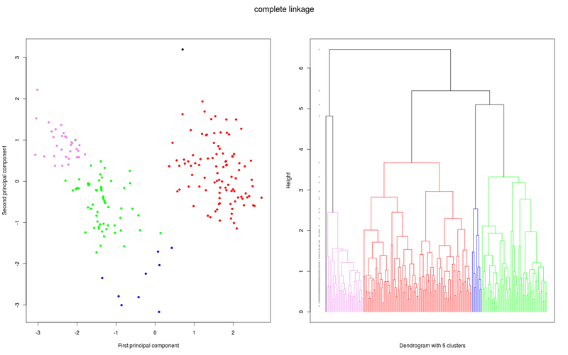

Slide 14
K-means vs. Hierarchical clustering
K-means :
Larger datasets
Globular data
Not reproductible
Hierarchical :
Choice of the numbers of clusters
Reproductible
Various ways of implementing it, and other algorithms

Slide 15
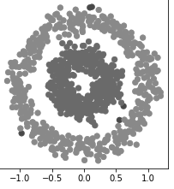
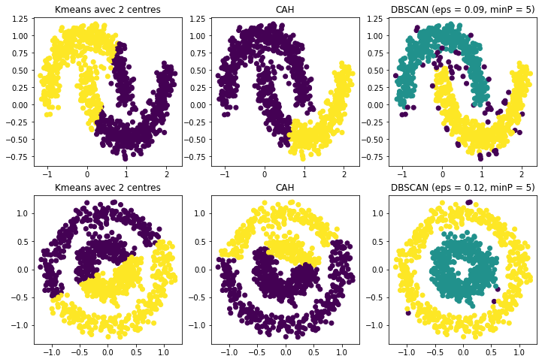
What you want

Slide 16

What you get with k-means 2 centers

Slide 17
DBSCAN does that, not k-means

